Slide 1

February 2026
Notes:
facility: exits, bathroom, kitchen for lunch and snacks,

Slide 2
Agenda
Great Plains Master Beekeeping Program
Introductions
Bee Sting Effects and Treatment
Winter Mortality of a Bee Colony
What’s Going on in Your Hives?

Slide 3
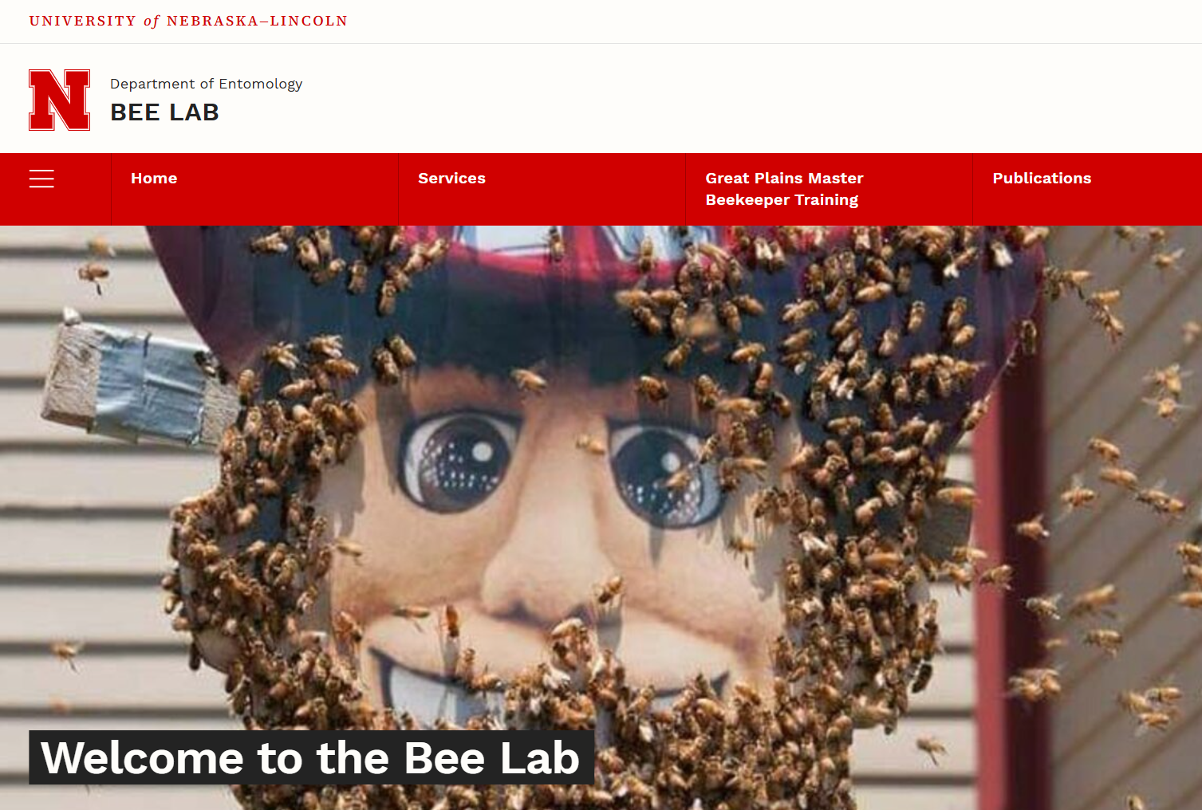
Jaevyn Hoyt
University of Nebraska’s Bee Lab
Great Plains Master Beekeeping Progam

Slide 4
Boone Regional Beekeepers Association
Monthly educational meetings
Access to member workshops and field days.
Socializing with beekeepers with broad ranges of experience
Mentoring opportunities
Opportunities for public education and outreach on beekeeping
Shared harvesting and building equipment (for an additional $15/year).
Website and Facebook group access
Notes:
Monthly educational meetings
Access to member workshops and field days
meetings are typically educational and relevant to the seasonal activities - guest speakers or hands on field days
Socializing with beekeepers with broad ranges of experience
Mentoring opportunities
approximately 80 members currently with decades of experience to first year beekeepers
Opportunities for public education and outreach on beekeeping
Local events & public speaking, other area groups
Shared harvesting and building equipment (for an additional $10/year).
$5/month or $15/month membership options
Website and Facebook group access

Slide 5
Introductions
Advisory Team New Members
Frank Thomas (Treasurer)
Carl Korschgen
Tom Coudron
Brenda Peculis
Clay Stem
Fred Durrenberger
Paul Beuselinck
L﻿eszek Vincent
M﻿ary Lorber
B﻿arry Stuart
C﻿J Lexow
V﻿ictoria Kelley
C﻿onnie Sievert
A﻿nthony Green
C﻿ecil Wilson
G﻿ary & Barbara Wright
Claire Drissell
Notes:
location, number of years of experience

Slide 6
Introductions
NAME
LOCATION
YEARS OF BEEKEEPING
STATUS OF BEES
2026 BEEKEEPING GOALS
Notes:
location, number of years of experience

Slide 7

Advisory Team Updates
1) 2026 Beginning Beekeeping Class Summary
Notes:
location, number of years of experience

Slide 8

Advisory Team Updates
Special Award
3)
Notes:
location, number of years of experience

Slide 9
Anaphylaxis
A Medical emergency

Slide 10
What is it?
Anaphylaxis, also known as anaphylactic shock, is a severe, rapid, life-threatening allergic reaction to a substance, such as the venom in a bee sting.
It can be fatal without prompt treatment!!

Slide 11
Other common things(triggers) that can cause it:
Insect stings from honeybees, wasps, yellow jackets, hornets, fire ants
Foods, such as peanuts, eggs, wheat and seafood
Medications, such as penicillin and other antibiotics
Latex, which is a common material in medical products such as gloves

Slide 12
Why does it occur?
A person’s immune system mistakenly identifies the substance as a threat, causing it to release chemicals, which lead to several symptoms. This can occur within a few minutes and affect multiple body systems.

Slide 13
What are the symptoms?
Airways constrict (become narrower), which causes the person to have difficulty breathing, shortness of breath and wheezing.
Anxiety results, and possibly confusion and slurred speech.

Slide 14
Any more symptoms?
Blood pressure drops, leading to dizziness and possible loss of consciousness.
Pulse becomes rapid and weak.
At this point the person enters a state of shock.

Slide 15
And more possible symptoms?
Hives any location on body
Swelling & redness in area of sting
Swollen tongue and throat
Abdominal pain
Vomiting

Slide 16
How is this condition treated?
Immediate injection or inhalation of epinephrine.
This is the same chemical as adrenaline, which is a hormone the body normally produces in much lower quantities.
Epinephrine works fast to reverse symptoms of allergic reactions.

Slide 17
Epinephrine
Available in 2 forms:
Injectable “Epi-pen”
Inhalable nasal spray “Neffy”
Both can be self-administered or given by someone else.

Slide 18
How to use Epi-pens and Neffy spray
Epi-pen: remove cap, inject into outer thigh muscle, even through clothing, and hold plunger down for 3-10 seconds. Syringe holds one dose.
Neffy spray: remove cap, insert straight into a nostril, use thumb to press plunger on device until it snaps up and sprays liquid into nostril. Person should not sniff during or after dose is given. Device holds one dose.

Slide 19
How and where do you get this medication?
If a person has had allergic reactions to bee stings in the past and discussed this with their doctor, their doctor has usually prescribed epinephrine for them. They should ALWAYS carry 2 doses with them when they are knowingly in the presence of bees. If the person does not have epinephrine with them, medical help will have to arrive to administer it.

Slide 20
What if symptoms don’t improve within about 5 minutes after giving a dose of epinephrine?
A second epi-pen injection can be given in the opposite or the same thigh.
A second Neffy nasal spray should be given in the same nostril as the first dose.

Slide 21
What else to do?
Call 911, even if the person’s condition seems to be improving. Everyone who experiences anaphylaxis needs an emergency medical evaluation as soon as possible.

Slide 22
And also….
Have the person lie flat and elevate both legs to improve blood flow.
Reassure him/her that more help is on the way.
Be ready to give a second dose of epinephrine if symptoms worsen.
If the person stops breathing, begin CPR immediately, and continue until help arrives!

Slide 23
Managing anaphylaxis effectively relies on:
1. quick recognition of symptoms
2. timely access to epinephrine
3. effective communication (with emergency responders)
4. monitoring person’s response to treatment

Slide 24
Carl Korschgen and Tom Coudron
Winter Mortality of a Bee Colony

Slide 25
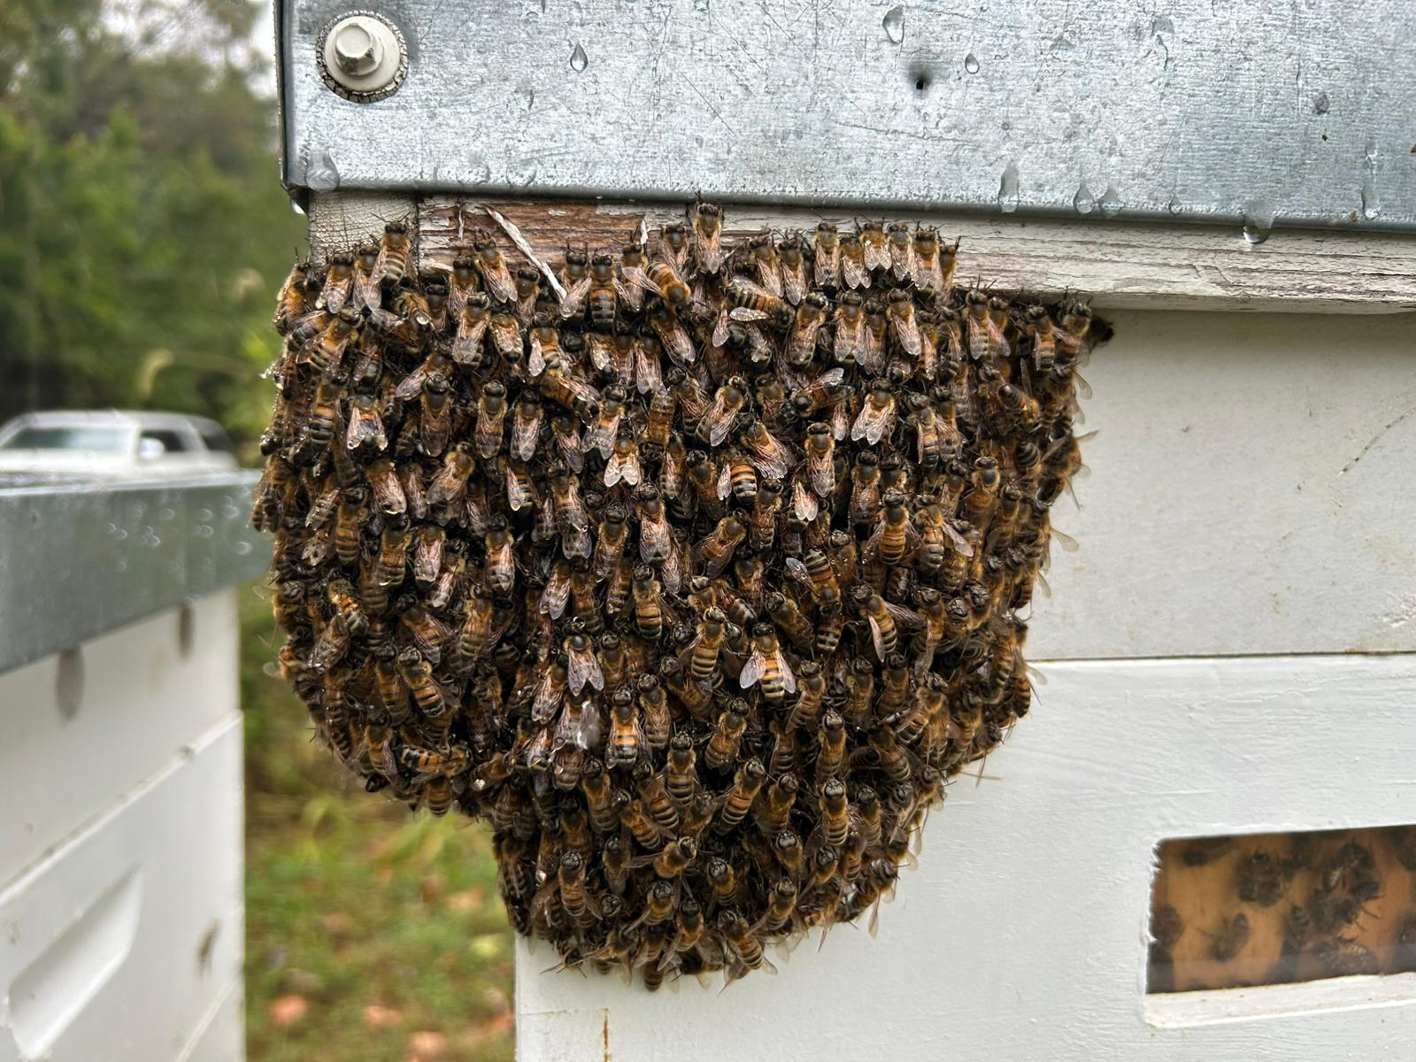
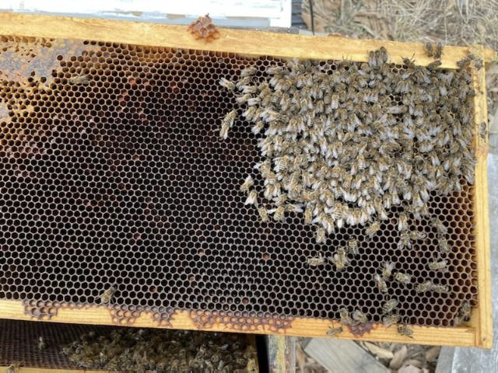
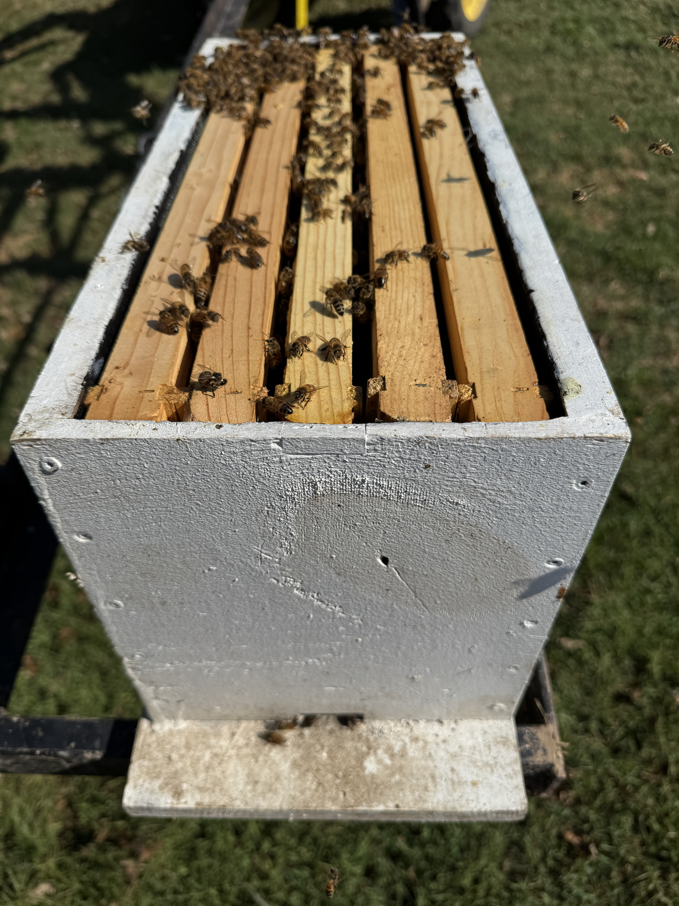
Winter Mortality of a Bee Colony –
What Went Wrong?
September 23, 2025
February 12, 2026

Slide 26
ABILITY OF COLONY TO GENERATE HEAT
COLD TEMPERATURE
SIZE OF CLUSTER

Slide 27
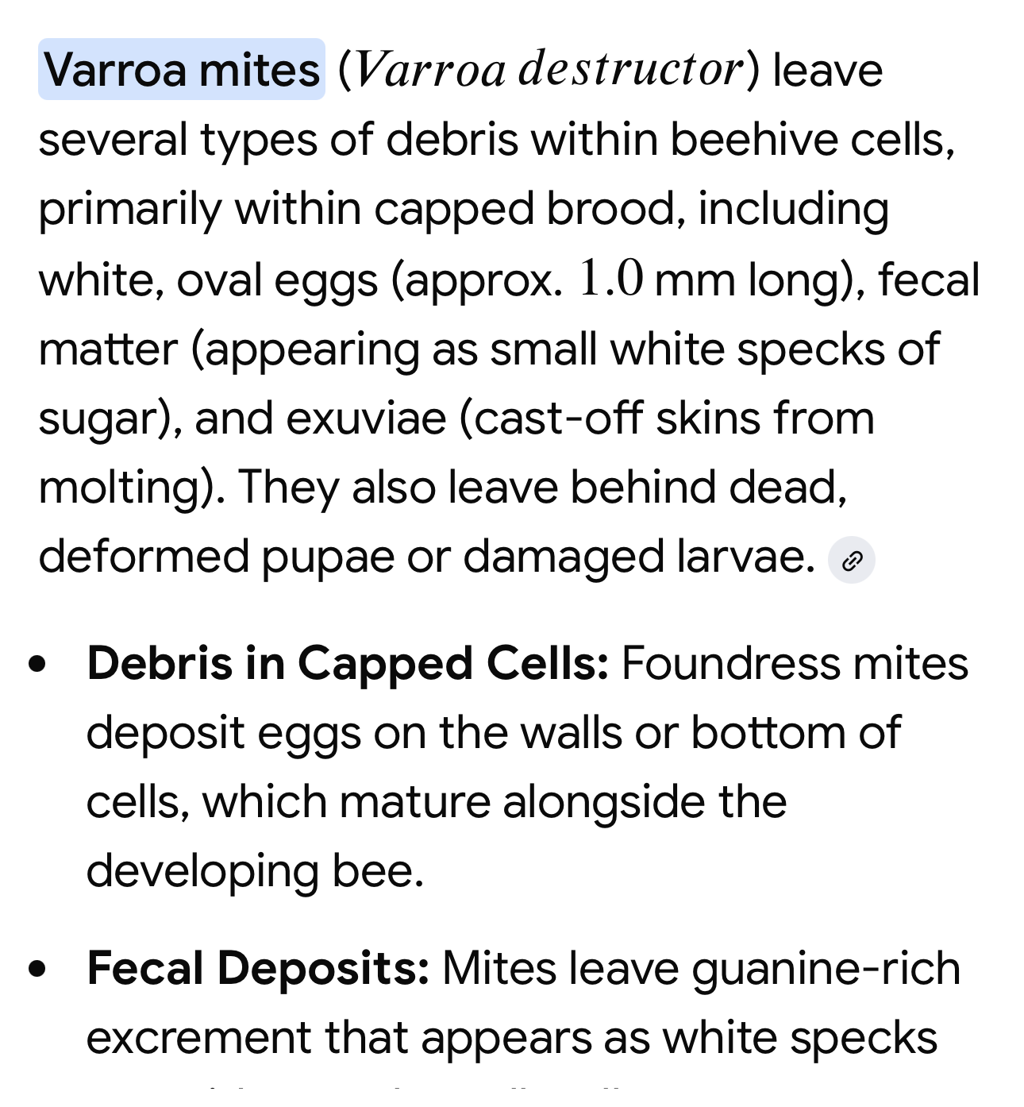
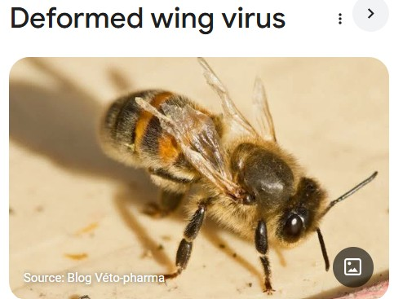
What about varroa mites?
Microscope examination:

Slide 28
What’s Going on in your hives?
Q & A

